Slide 1

How do Organisms
Reproduce?
Modes of reproduction used by single
organisms
(Budding, Vegetative propagation)

Slide 2
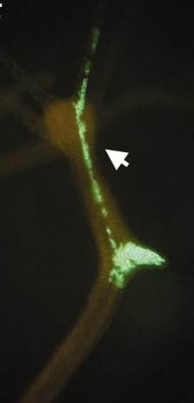
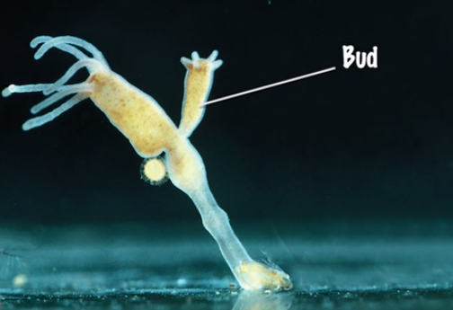
Budding
Seen in hydra.
Regenerative cells.

Slide 3
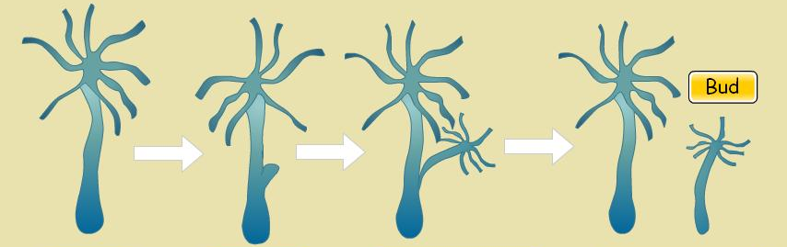
Budding
Regenerative cells
Due to repeated cell division at one specific site
Outgrowth
Bud
specific site
Bud
When fully mature- detach from parent body- become new independent individuals.
These buds develop into tiny individuals.

Slide 4
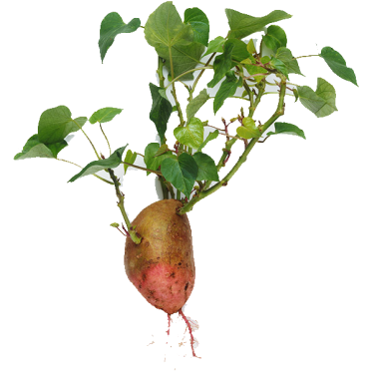
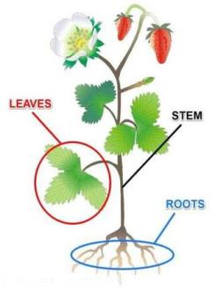
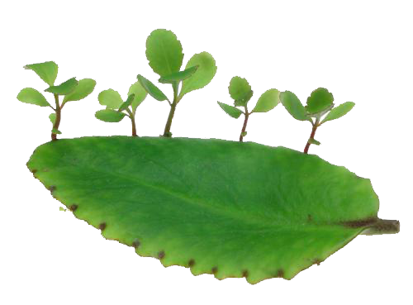
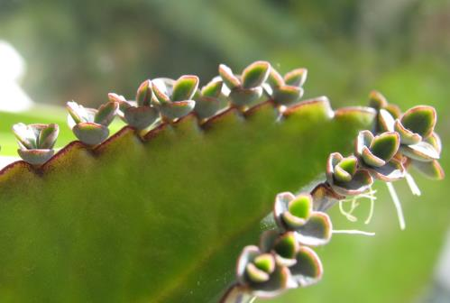
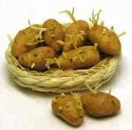
Vegetative propagation
Plants
Roots, stem, leaves
Develop into new plants
Vegetative organs like

Slide 5
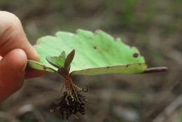
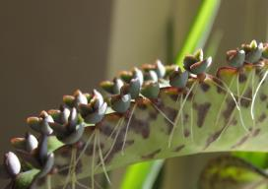
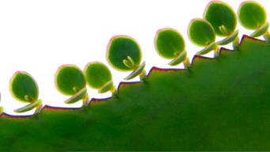
Vegetative propagation
Bryophyllum
Develop into a new plant
Buds are produced
in the notches along the leaf margin

Slide 6
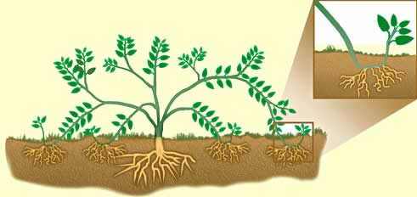
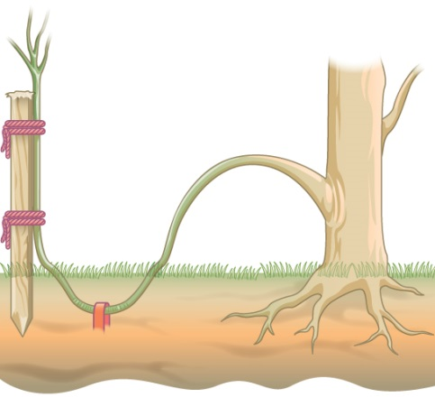
Vegetative propagation
This property of vegetative propagation is used in methods such as layering or grafting to grow many plants like sugarcane, roses, or grapes for agricultural purposes.

Slide 7
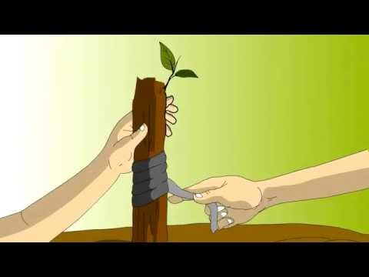
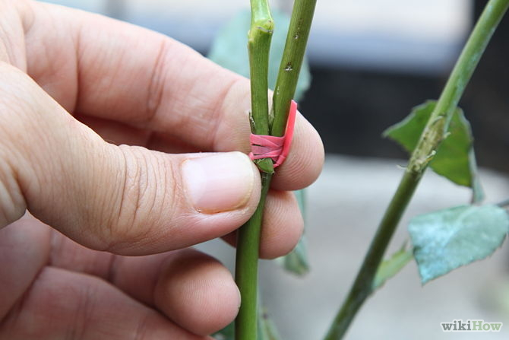
Vegetative propagation
This property of vegetative propagation is used in methods such as layering or grafting to grow many plants like sugarcane, roses, or grapes for agricultural purposes.

Slide 8
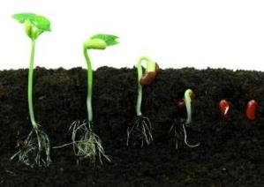
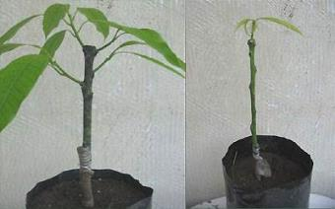
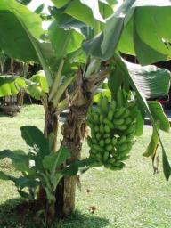
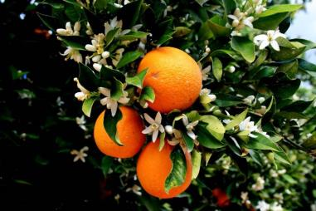
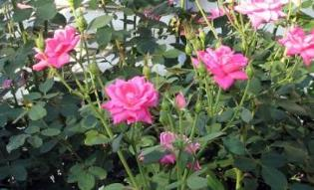
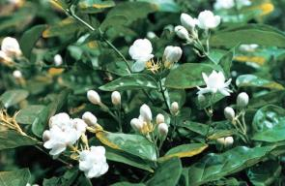
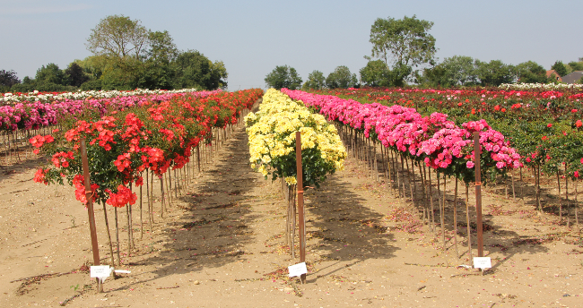
Vegetative propagation
Advantages
Plants can bear flowers and fruits earlier than those produced from seeds.
Also use to propagate plants that have lost the capacity to produced seeds – banana, orange, rose, jasmine.
Plants produced are genetically similar to the parent plant to have all its characteristics.

Slide 9
Thank You

